Slide 1
Local features (Szeliski 4.1)
Michael S. Ryoo

Slide 2

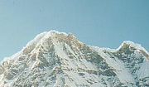
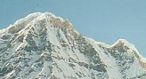
Local features: main components
Detection: Identify the interest points
Description: Extract vector feature descriptor surrounding each interest point.
Matching: Determine correspondence between descriptors in two views
1
Kristen Grauman
Notes:
1

Slide 3
Local features: desired properties
Repeatability
The same feature can be found in several images despite geometric and photometric transformations
Saliency
Each feature has a distinctive description
Compactness and efficiency
Many fewer features than image pixels
Locality
A feature occupies a relatively small area of the image; robust to clutter and occlusion
1

Slide 4
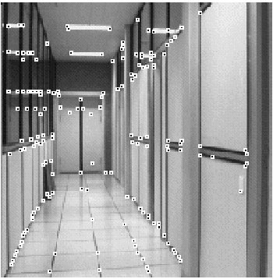
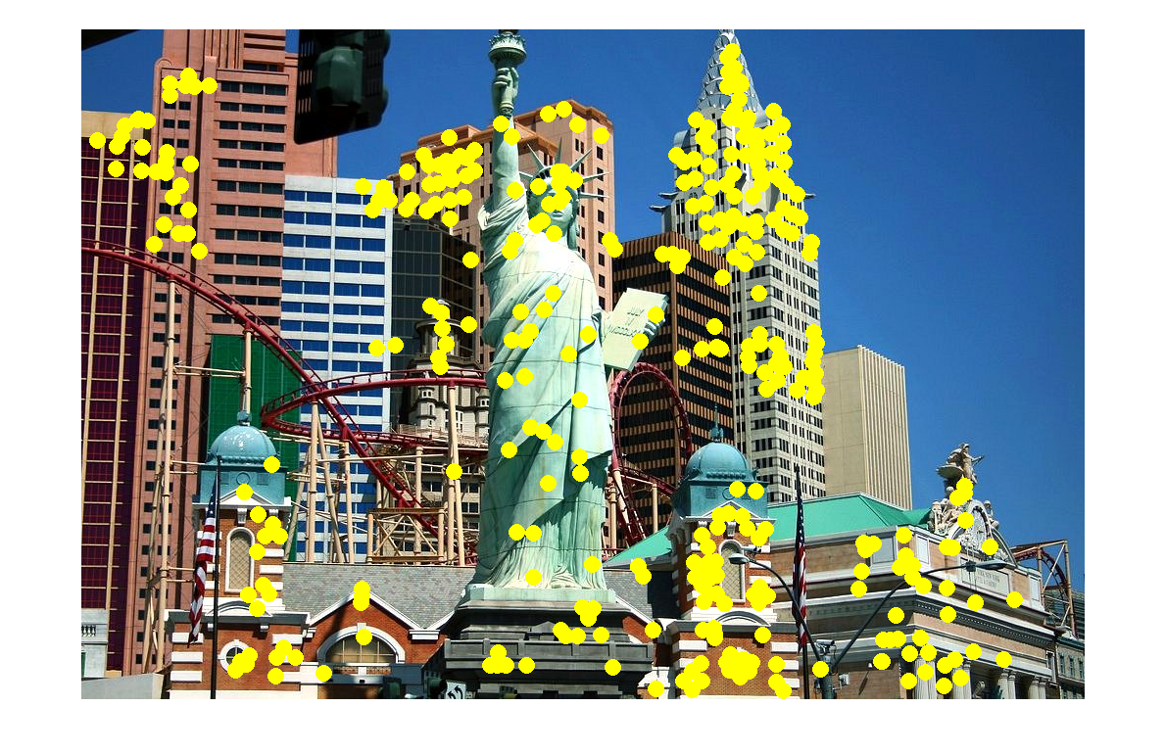
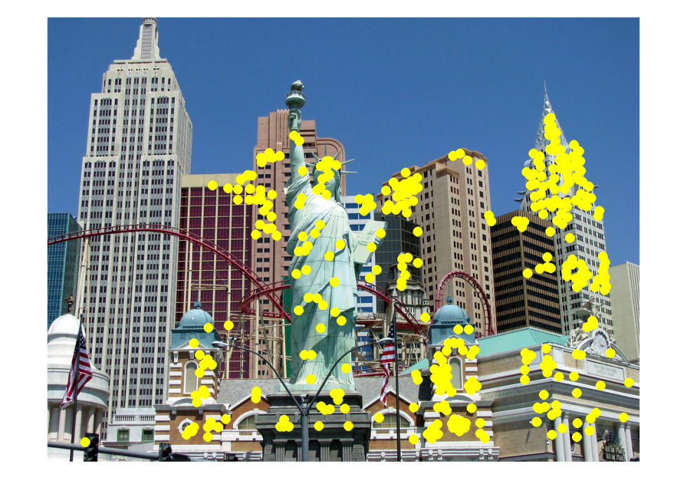
Applications
Local features are used for:
Image alignment
3D reconstruction
Motion tracking
Robot navigation
Indexing and database retrieval
Object recognition
1
Lana Lazebnik
Notes:
1

Slide 5
Goal: interest operator repeatability
We want to detect (at least some of) the same points in both images.
Yet we have to be able to run the detection procedure independently per image.
No chance to find true matches!
1
Notes:
1
1

Slide 6
Goal: descriptor distinctiveness
We want to be able to reliably determine which point goes with which.
Must provide some invariance to geometric and photometric differences between the two views.
?
1
Notes:
1

Slide 7
Local features: main components
Detection: Identify the interest points
Description:Extract vector feature descriptor surrounding each interest point.
Matching: Determine correspondence between descriptors in two views
1
Notes:
1

Slide 8
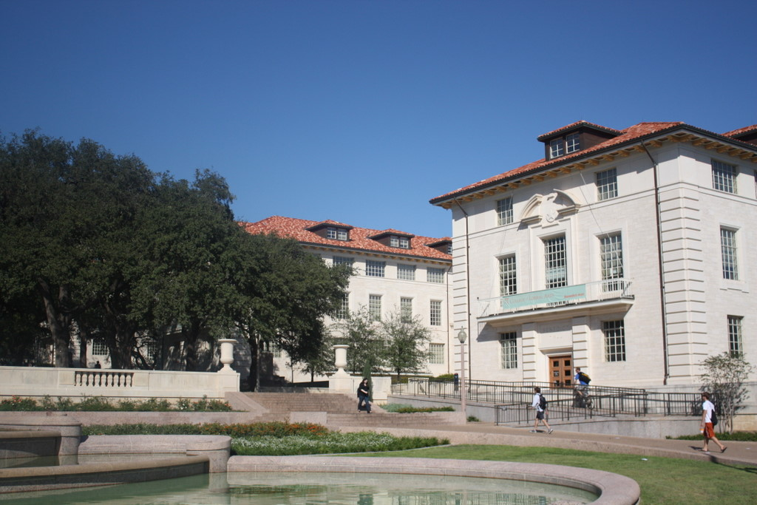
What points would you choose?
1
Notes:
1

Slide 9

Corners as distinctive interest points
We should easily recognize the point by looking through a small window
Shifting a window in any direction should give a large change in intensity
“flat” region: no change in all directions
“edge”: no change along the edge direction
“corner”: significant change in all directions
1
Slide credit: Alyosha Efros, Darya Frolova, Denis Simakov
Notes:
1

Slide 10
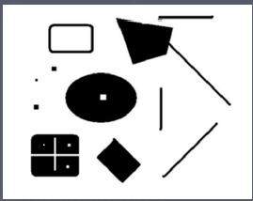
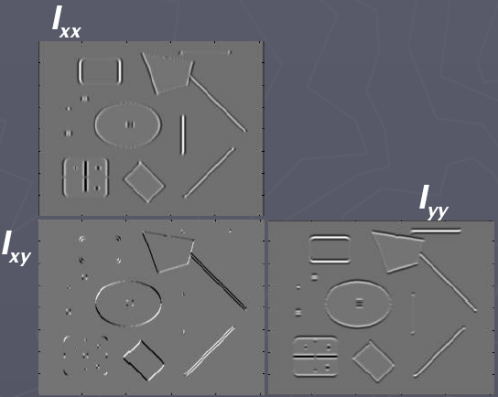
Corners as distinctive interest points
2 x 2 matrix of image derivatives (averaged in neighborhood of a point).
Notation:
1
Notes:
1

Slide 11
Example of Harris application
1
Kristen Grauman

Slide 12
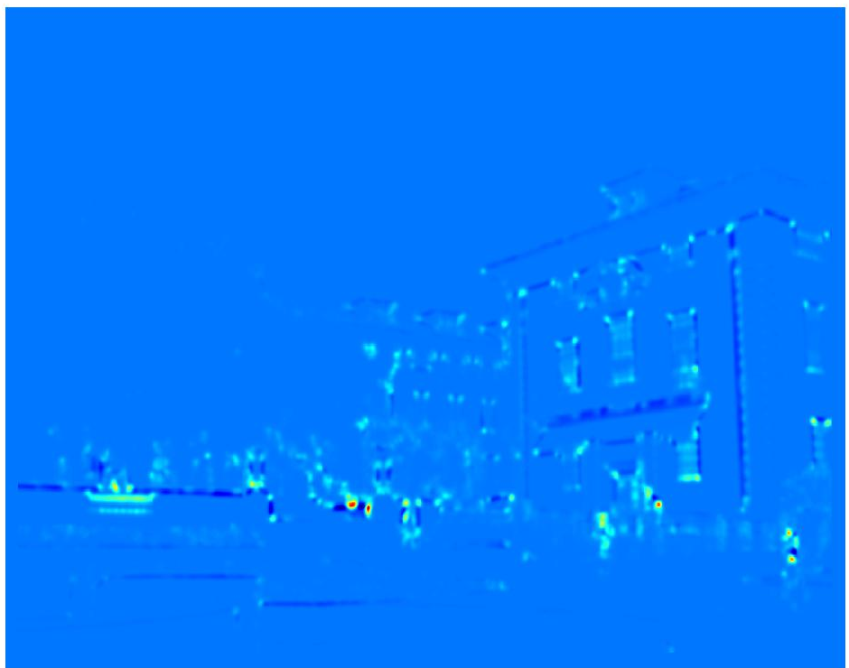
Example of Harris application
Compute corner response at every pixel.
1
Kristen Grauman
Notes:
1

Slide 13
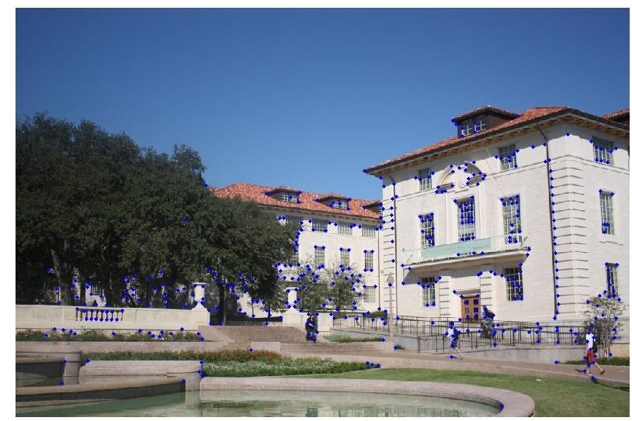
Example of Harris application
1
Kristen Grauman
Notes:
Only non-maxes exceeding average (thresholded)
1

Slide 14
Properties of the Harris corner detector
Rotation invariant?
Yes
1

Slide 15
Properties of the Harris corner detector
Rotation invariant?
Translation invariant?
Yes
Yes
1

Slide 16
Properties of the Harris corner detector
Rotation invariant?
Translation invariant?
Scale invariant?
Yes
Yes
No
All points will be classified as edges
Corner !
1

Slide 17
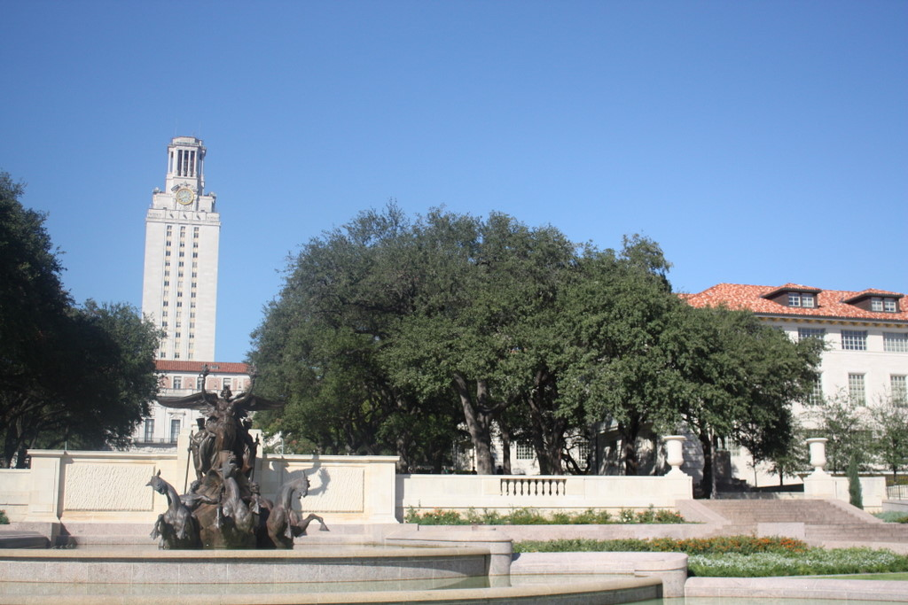
Scale invariant interest points
How can we independently select interest points in each image, such that the detections are repeatable across different scales?
1
Kristen Grauman
Notes:
1

Slide 18
Automatic scale selection
Intuition:
Find scale that gives local maxima of some function f in both position and scale.
f
f
Image 1
Image 2
s₁
region size
s₂
region size
Slide credit: Kristen Grauman
1
Notes:
1

Slide 19
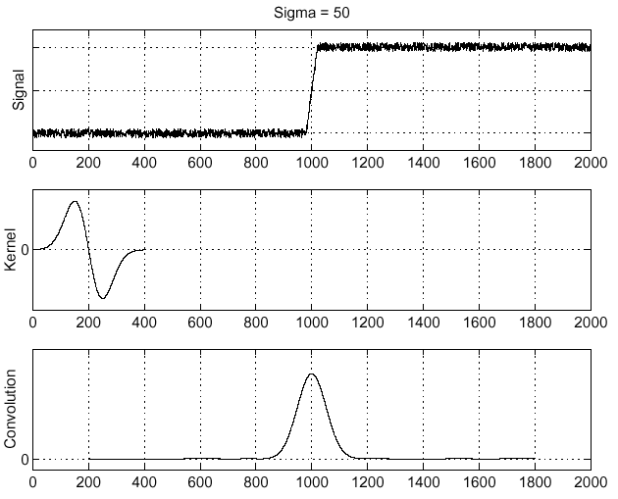
Recall: Edge detection
Edge
f
Derivative of Gaussian
Edge = maximum of derivative
1
Source: S. Seitz
Notes:
1

Slide 20
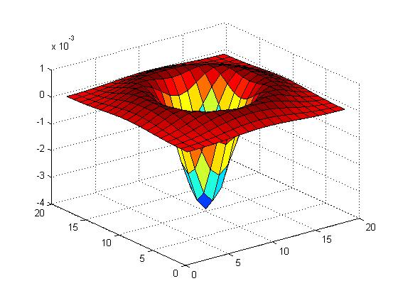

Blob detection in 2D
Laplacian of Gaussian: Circularly symmetric operator for blob detection in 2D
1
Notes:
1

Slide 21
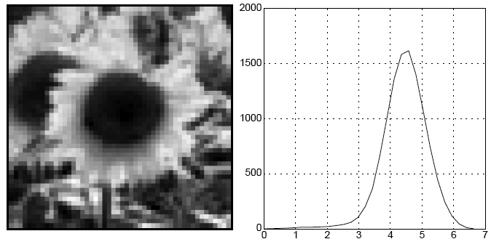
Blob detection in 2D
We define the characteristic scale as the scale that produces peak of Laplacian response
characteristic scale
1
Slide credit: Lana Lazebnik
Notes:
1

Slide 22
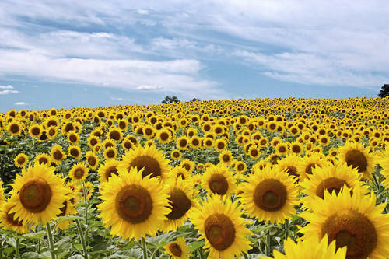
Example
Kristen Grauman
1

Slide 23
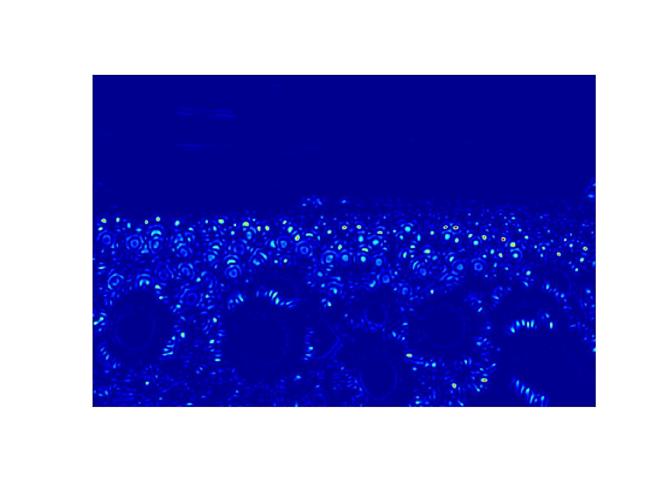
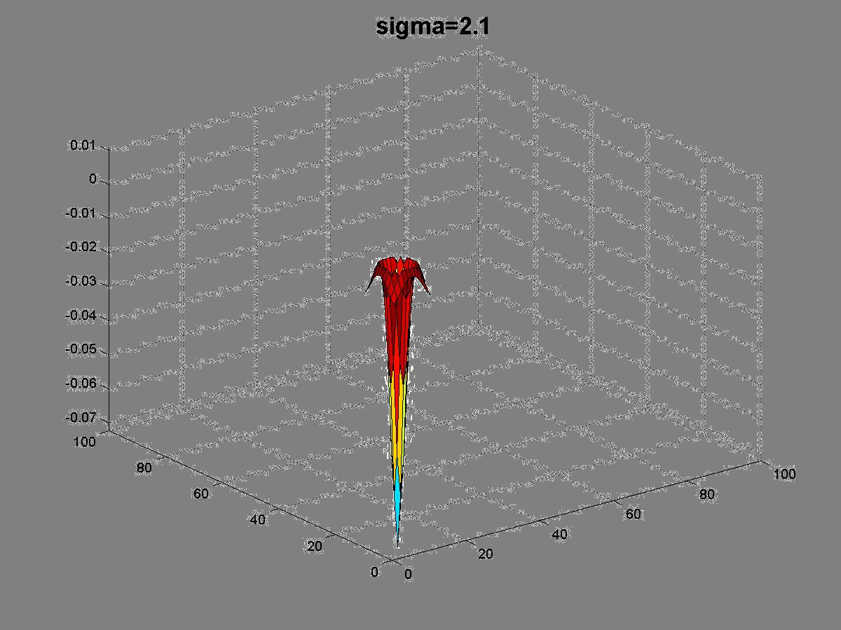
1
Kristen Grauman

Slide 24
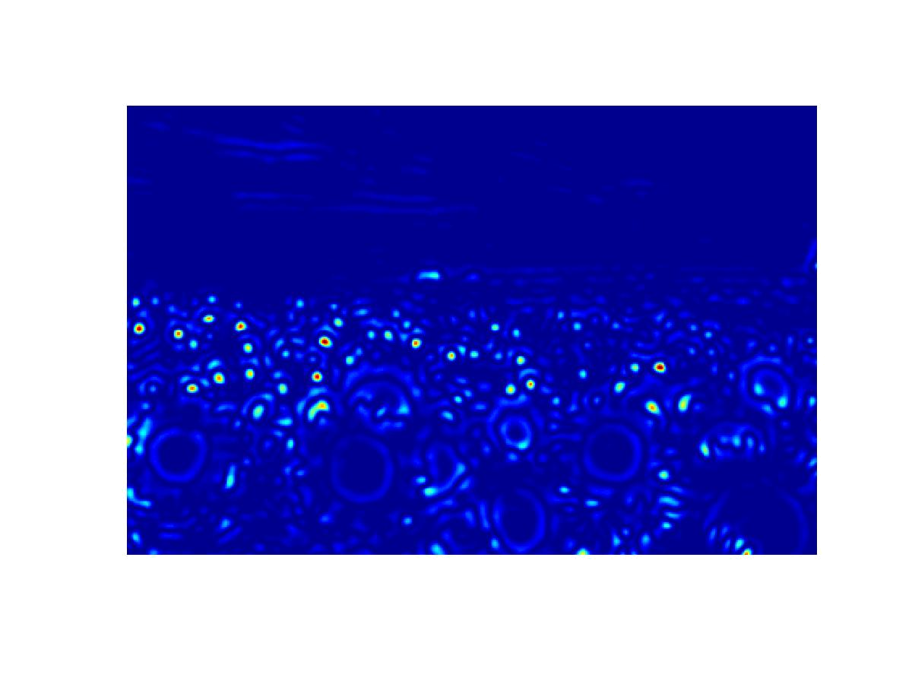
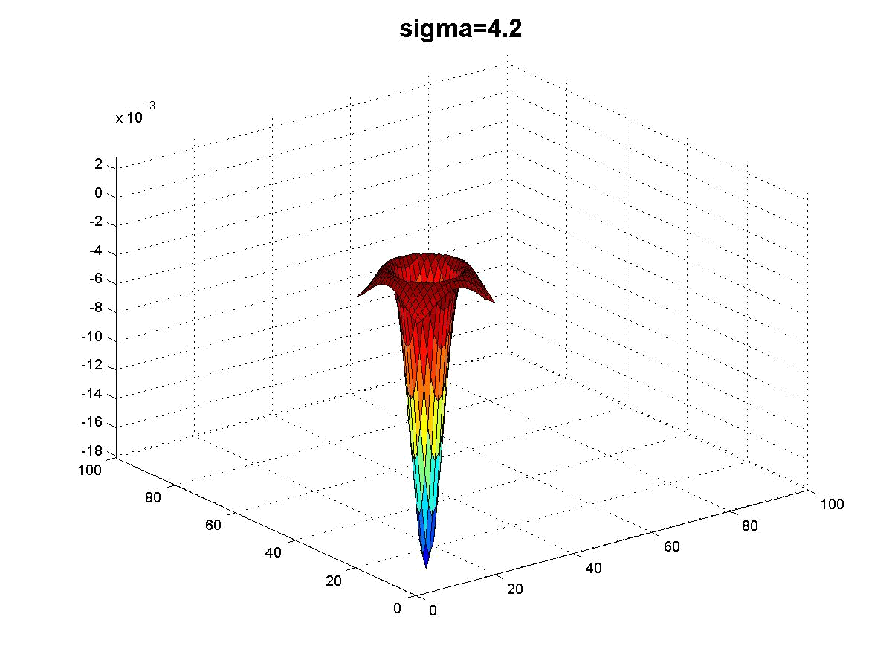
1
Kristen Grauman

Slide 25
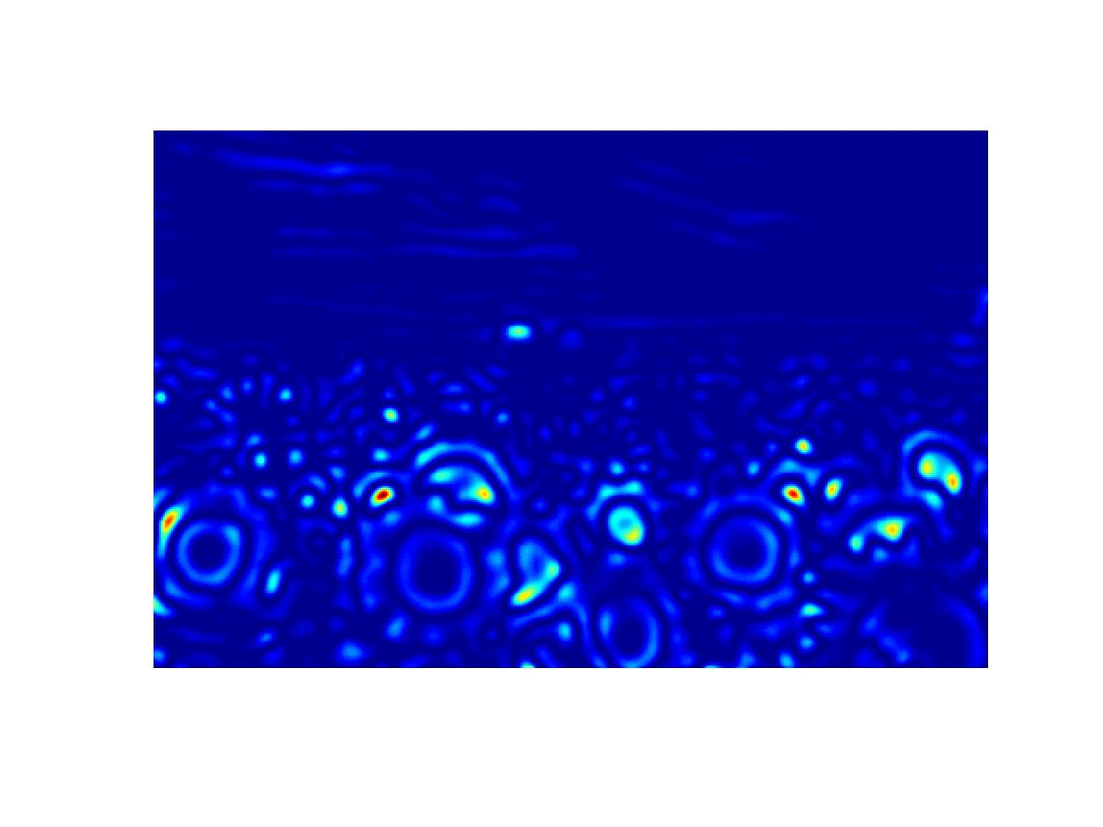
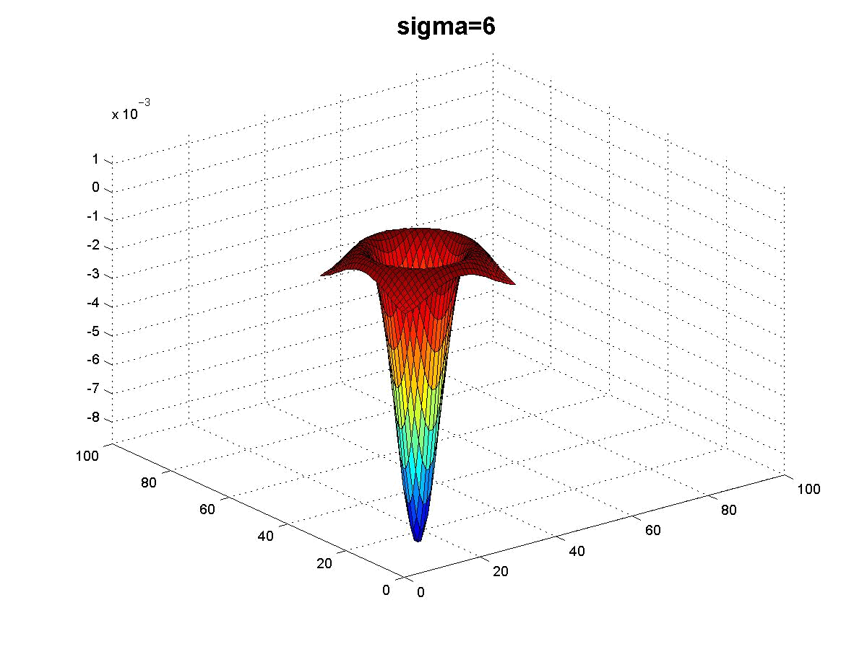
1
Kristen Grauman

Slide 26
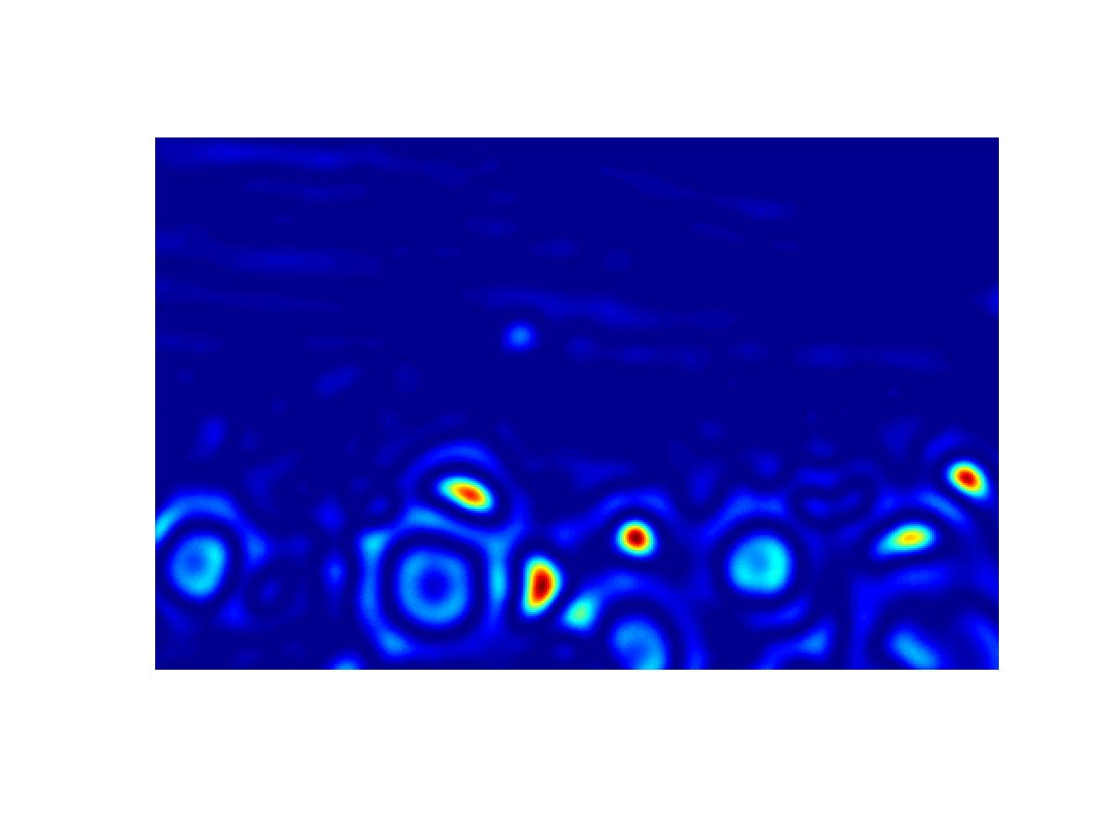
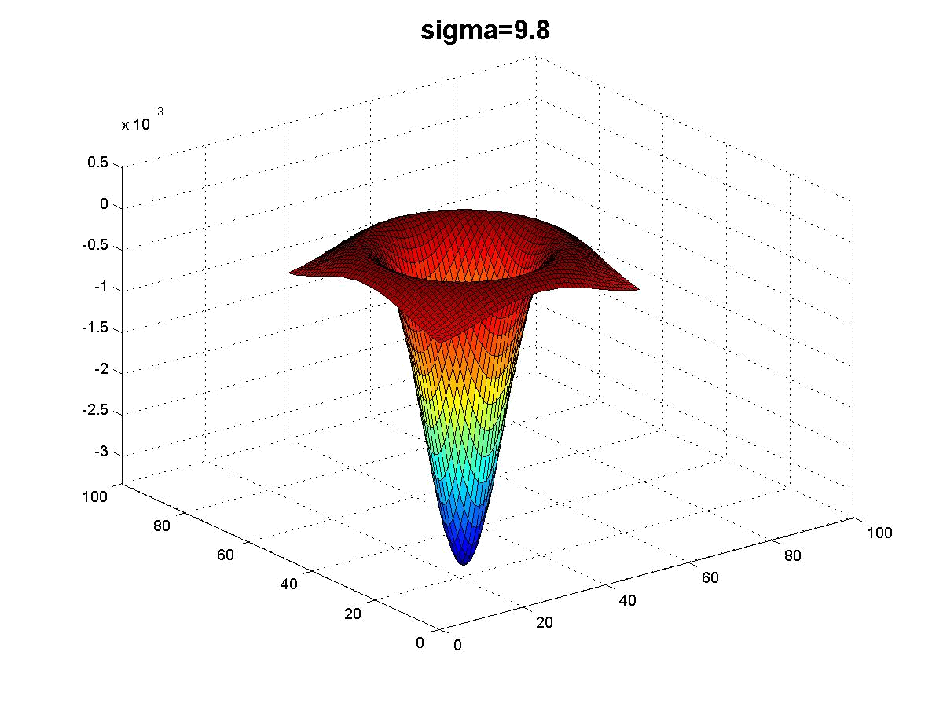
1
Kristen Grauman

Slide 27
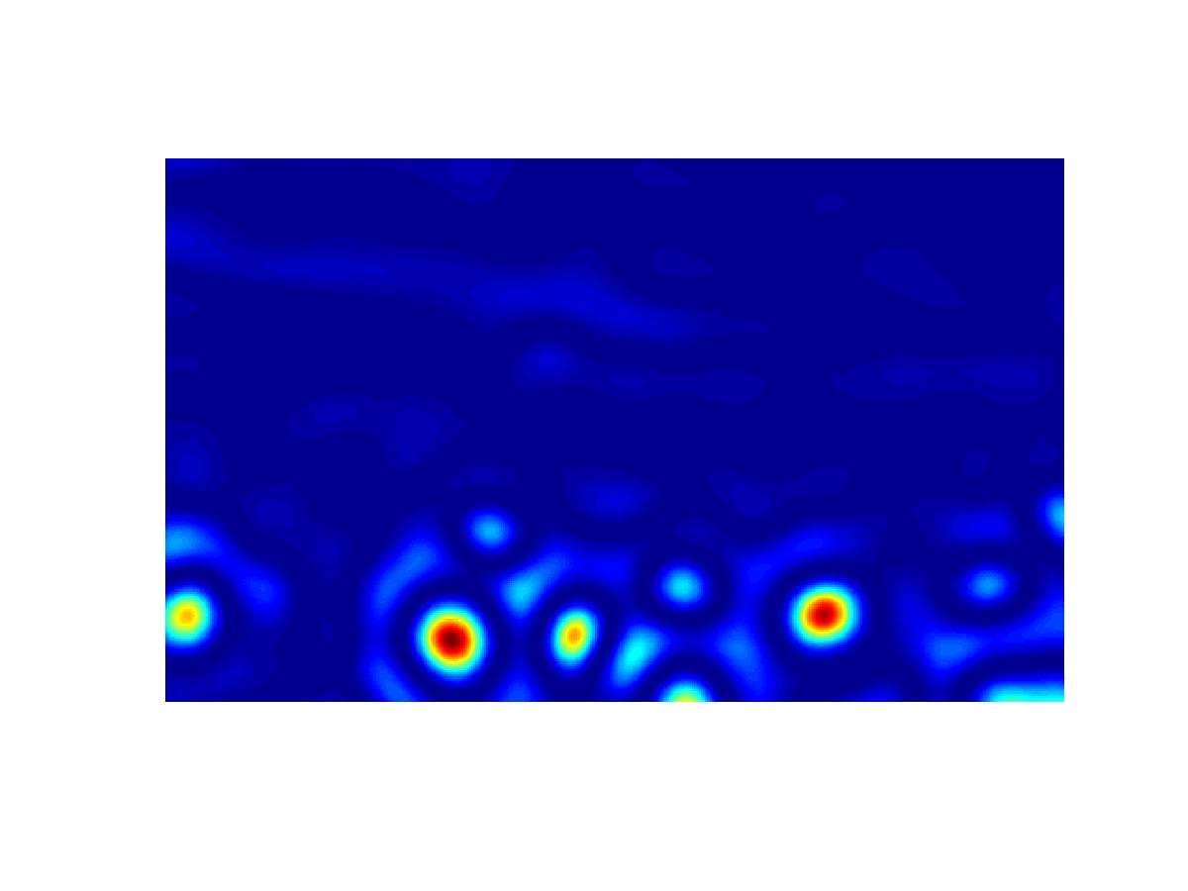
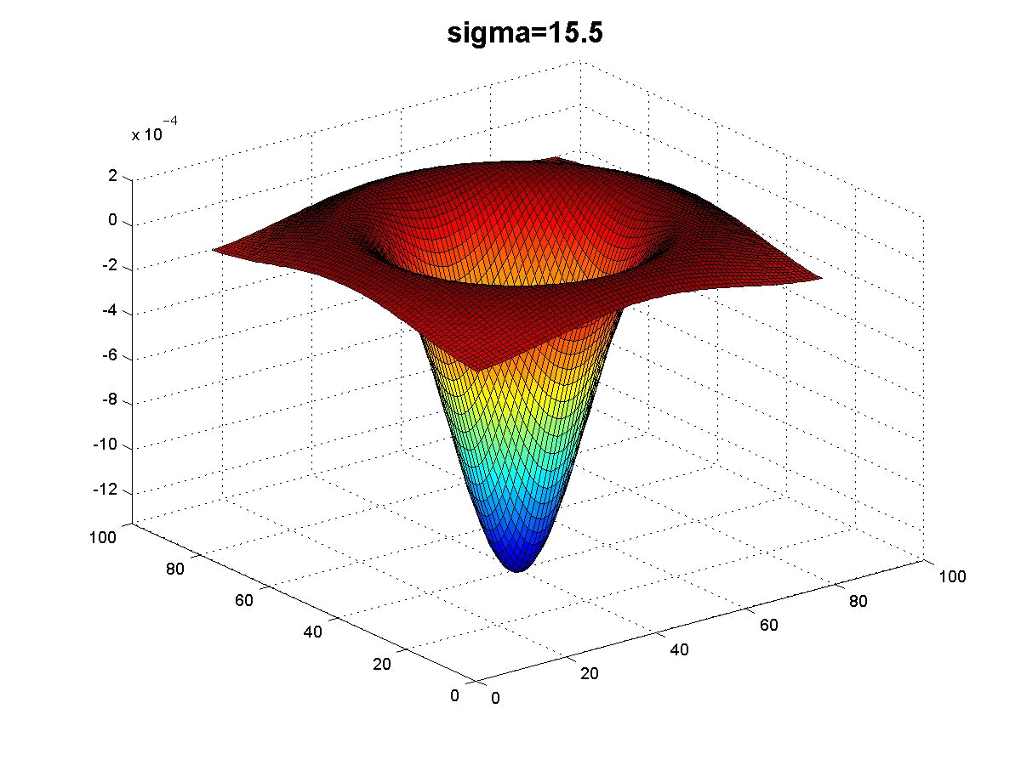
1
Kristen Grauman

Slide 28
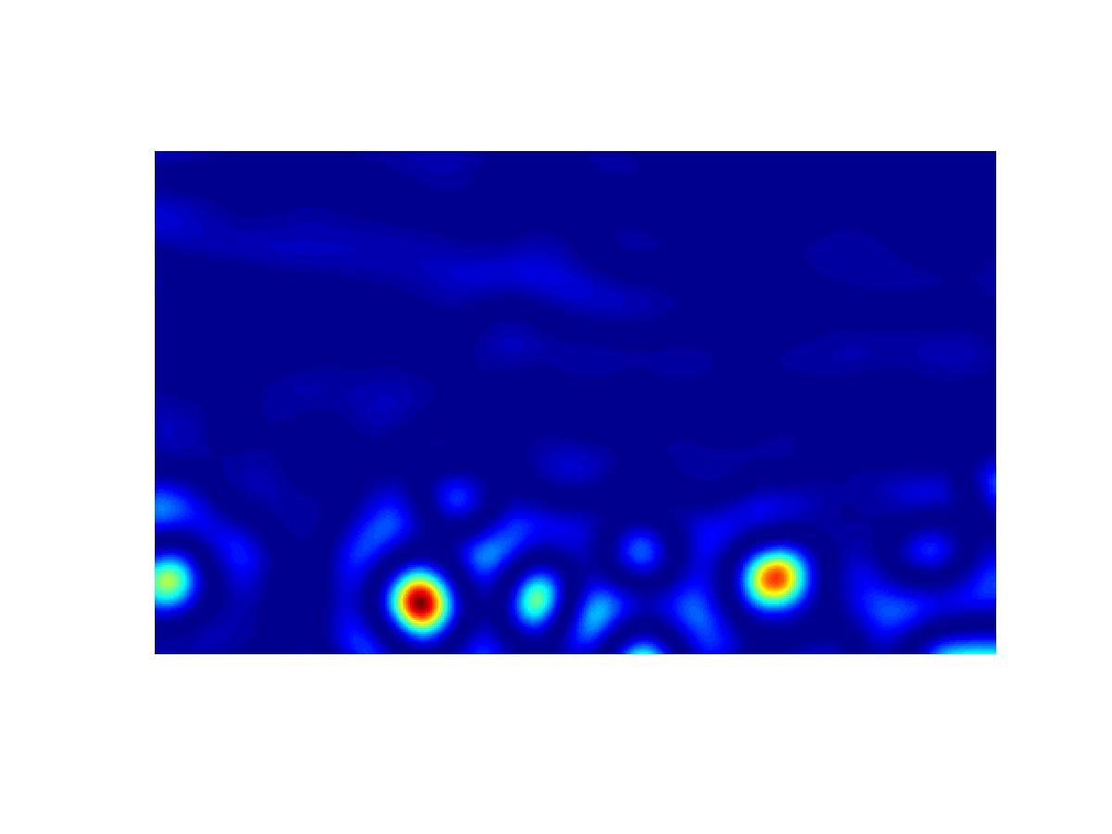
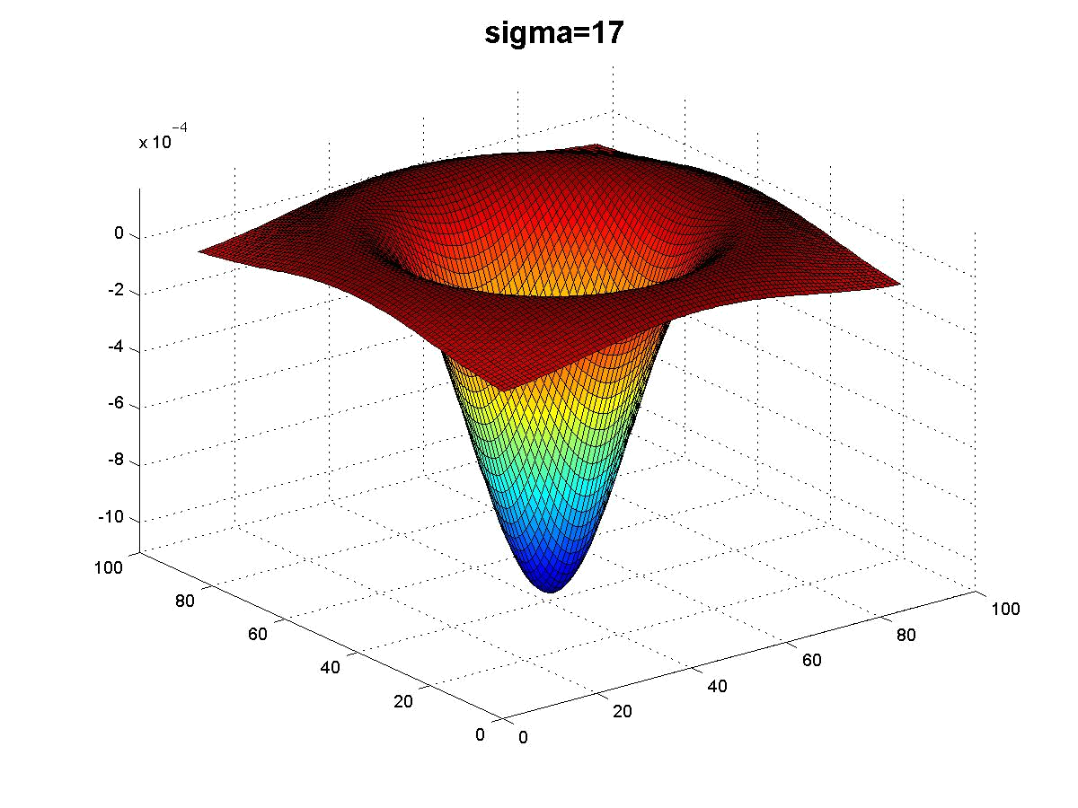
1
Kristen Grauman

Slide 29
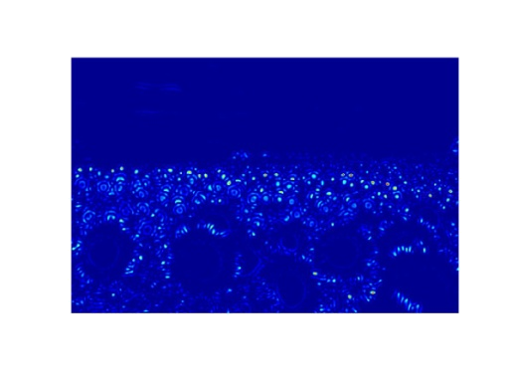
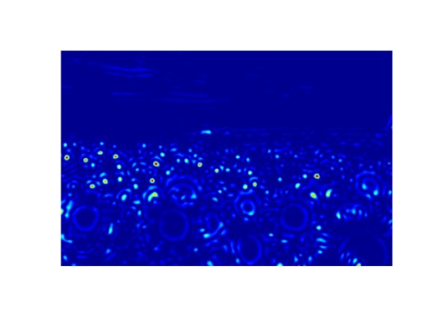
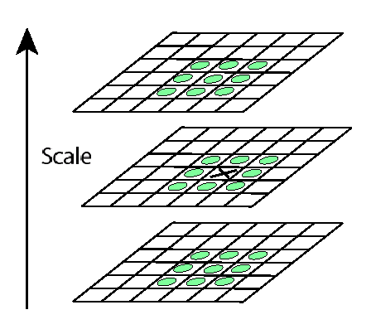



Scale invariant interest points
Interest points are local maxima in both position and scale.
σ5
σ4
scale
σ3
σ2
⇒ List of (x, y, σ)
σ1
Squared filter response maps
1
Kristen Grauman
Notes:
1

Slide 30
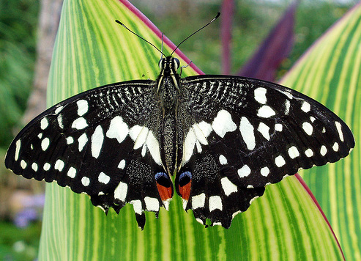
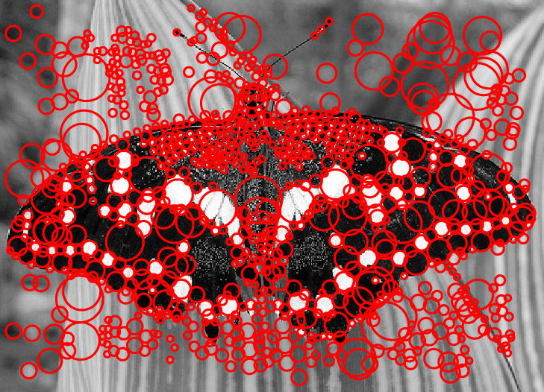
Scale-space blob detector: Example
1
Image credit: Lana Lazebnik
Notes:
1

Slide 31
Local features: main components
Detection: Identify the interest points
Description: Extract vector feature descriptor surrounding each interest point.
Matching: Determine correspondence between descriptors in two views
1
Slide credit: Kristen Grauman
Notes:
1

Slide 32
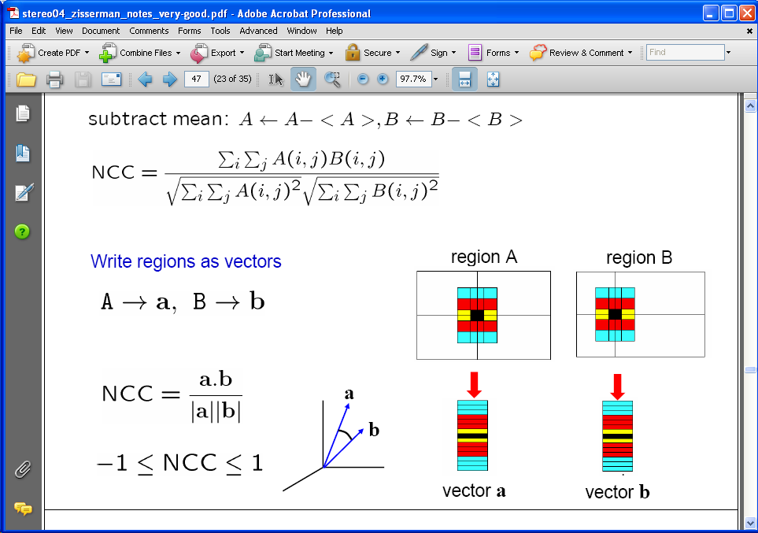
Raw patches as local descriptors
The simplest way to describe the neighborhood around an interest point is to write down the list of intensities to form a feature vector.
But this is very sensitive to even small shifts, rotations.
1
Slide credit: Kristen Grauman

Slide 33

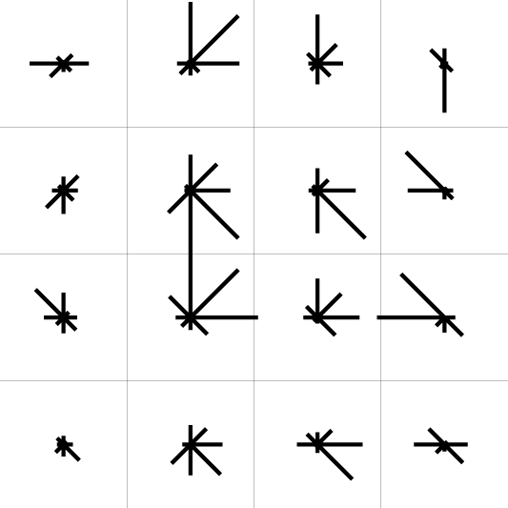
SIFT descriptor [Lowe 2004]
Use histograms to bin pixels within sub-patches according to their orientation.
0
2
π
Why subpatches?
Why does SIFT have some illumination invariance?
1
Slide credit: Kristen Grauman
Notes:
1

Slide 34
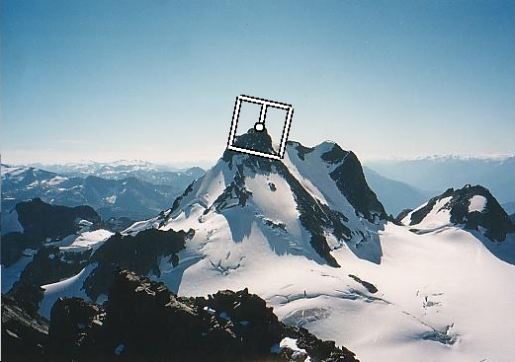
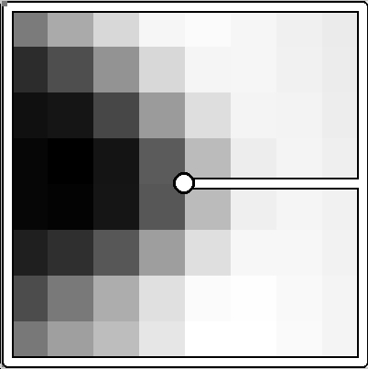
Making descriptor rotation invariant
CSE 576: Computer Vision
Rotate patch according to its dominant gradient orientation
This puts the patches into a canonical orientation.
1
Image from Matthew Brown
Notes:
1

Slide 35
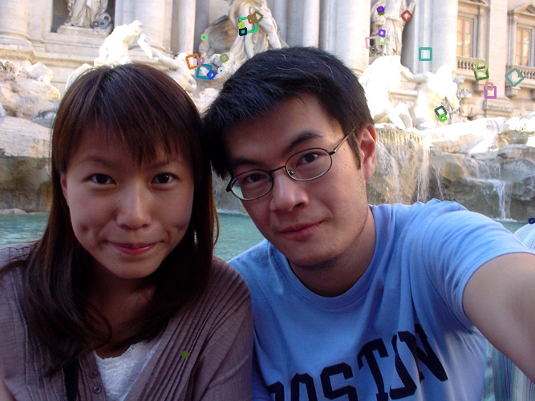
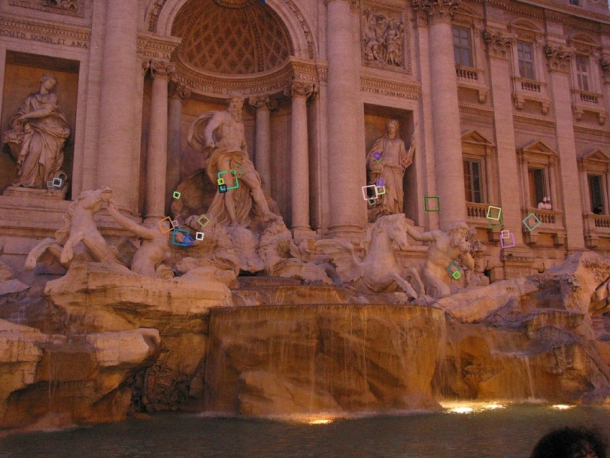
SIFT descriptor [Lowe 2004]
Extraordinarily robust matching technique
Can handle changes in viewpoint
Up to about 60 degree out of plane rotation
Can handle significant changes in illumination
Sometimes even day vs. night (below)
Fast and efficient—can run in real time
Lots of code available
http://people.csail.mit.edu/albert/ladypack/wiki/index.php/Known_implementations_of_SIFT
<number>
Steve Seitz
Notes:
1

Slide 36
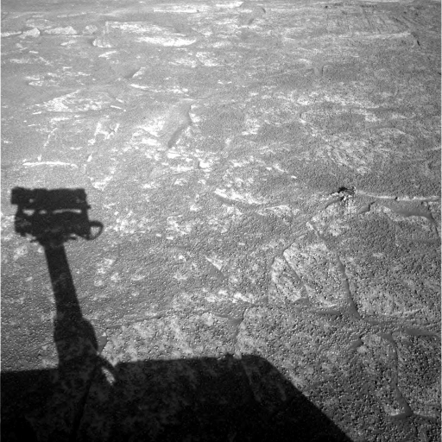
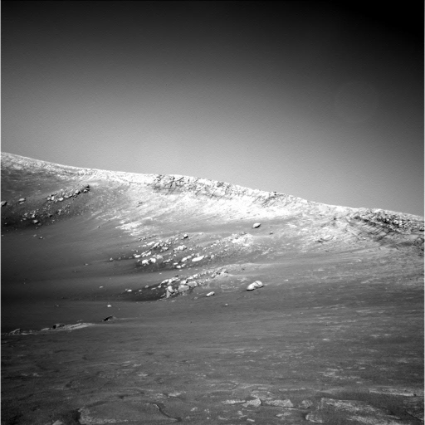
Example
NASA Mars Rover images
1

Slide 37
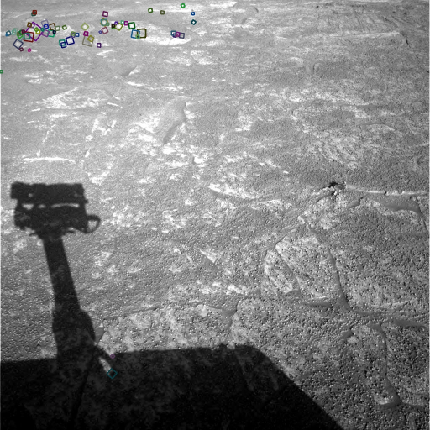
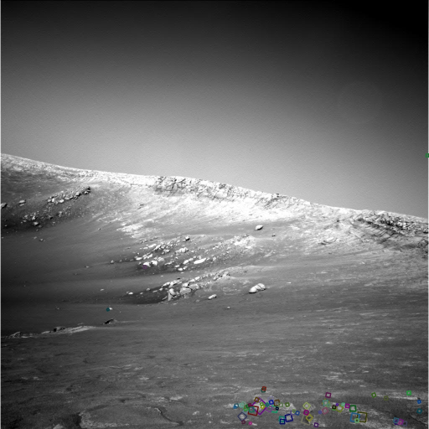
Example
NASA Mars Rover images
with SIFT feature matches Figure by Noah Snavely
1
Notes:
1

Slide 38
SIFT descriptor properties
Invariant to
Scale
Rotation
Partially invariant to
Illumination changes
Camera viewpoint
Occlusion, clutter
1
Slide credit: Kristen Grauman
Notes:
1

Slide 39
Local features: main components
Detection: Identify the interest points
Description:Extract vector feature descriptor surrounding each interest point.
Matching: Determine correspondence between descriptors in two views
1
Slide credit: Kristen Grauman
Notes:
1

Slide 40
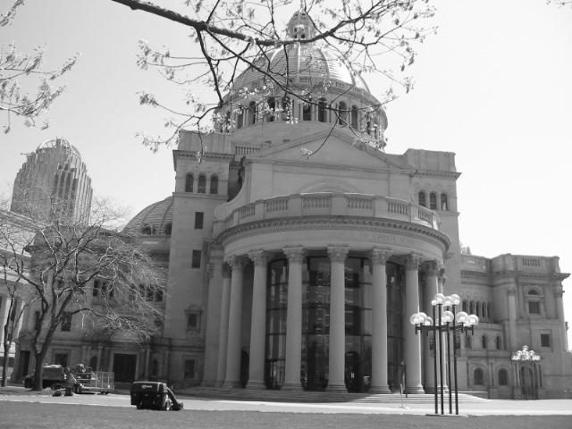
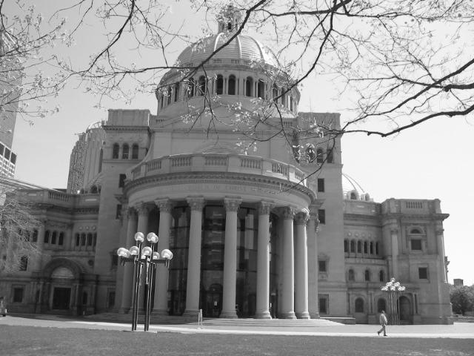
Matching local features
1
Kristen Grauman
Notes:
1

Slide 41
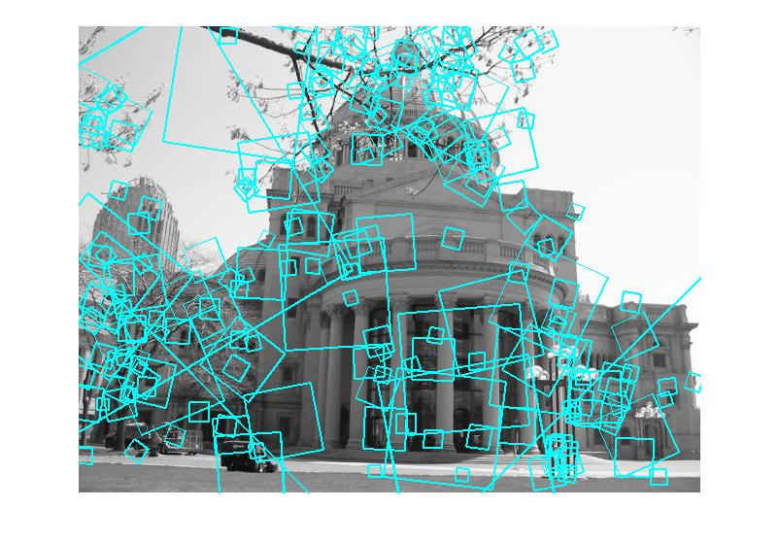
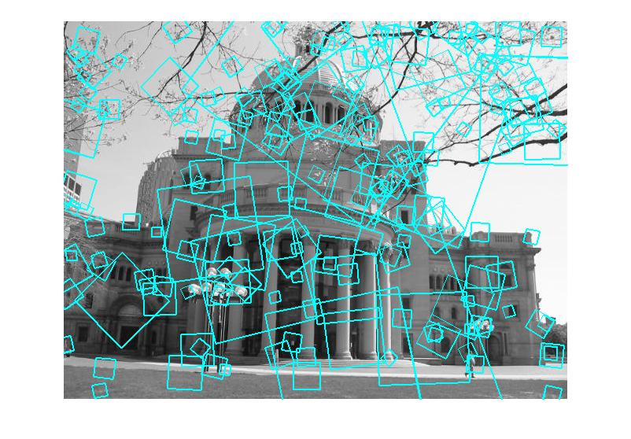
Matching local features
?
Image 1
Image 2
To generate candidate matches, find patches that have the most similar appearance (e.g., lowest SSD)
Simplest approach: compare them all, take the closest (or closest k, or within a thresholded distance)
1
Kristen Grauman

Slide 42

Robust feature-based alignment
Extract features
Compute putative matches
Loop:
Hypothesize transformation T (small group of putative matches that are related by T)
Verify transformation (search for other matches consistent with T)
1
Source: L. Lazebnik
Notes:
1

Slide 43
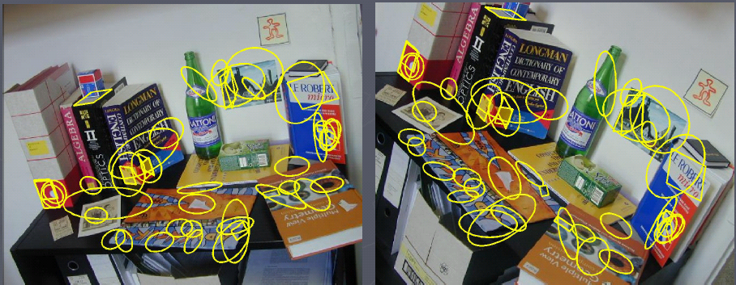
Wide baseline stereo
[Image from T. Tuytelaars ECCV 2006 tutorial]
1
Notes:
1

Slide 44
Summary
Interest point detection
Harris corner detector
Laplacian of Gaussian, automatic scale selection
Invariant descriptors
Rotation according to dominant gradient direction
Histograms for robustness to small shifts and translations (SIFT descriptor)
1
Notes:
1

Slide 45
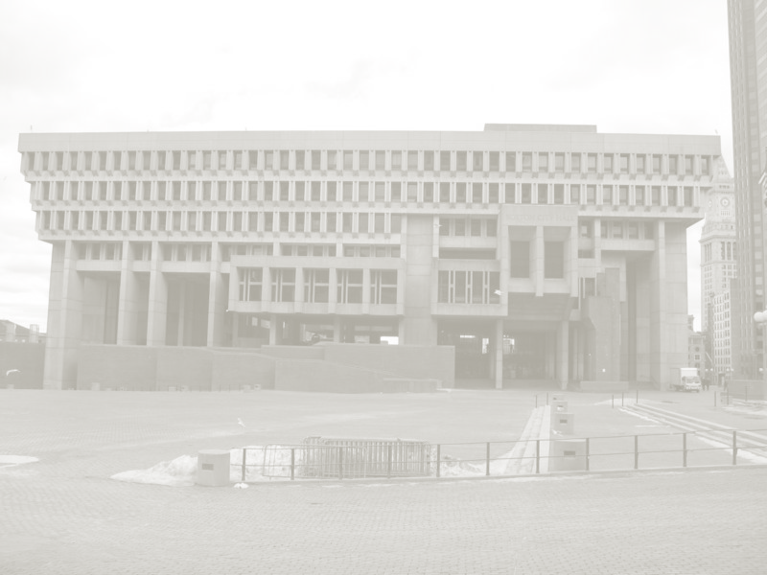
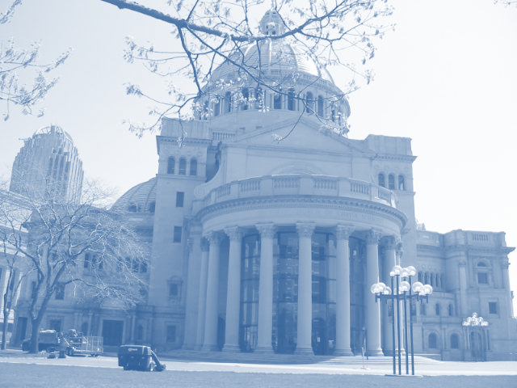
Indexing local features
…
1
Kristen Grauman
Notes:
Map local descriptors to discrete tokens, and then “match” them by simply looking up features assigned to identical tokens.
1
CS 376 Lecture 18

Slide 46
Indexing local features
Each patch / region has a descriptor, which is a point in some high-dimensional feature space (e.g., SIFT)
Descriptor’s feature space
1
Kristen Grauman
Notes:
1
<number>
CS 376 Lecture 18

Slide 47
Indexing local features
…
1
Kristen Grauman
Notes:
Map local descriptors to discrete tokens, and then “match” them by simply looking up features assigned to identical tokens.
1
CS 376 Lecture 18

Slide 48
Indexing local features
…
1
Kristen Grauman
Notes:
Map local descriptors to discrete tokens, and then “match” them by simply looking up features assigned to identical tokens.
1
CS 376 Lecture 18

Slide 49
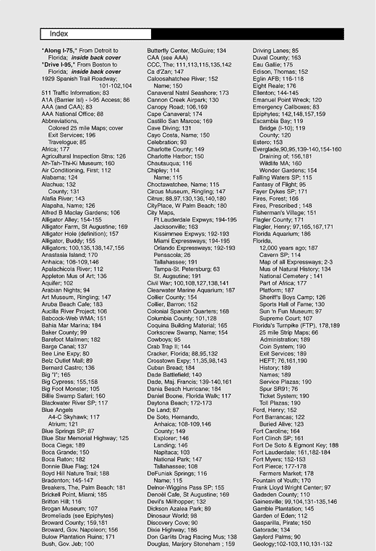
Indexing local features: inverted file index
For text documents, an efficient way to find all pages on which a word occurs is to use an index…
We want to find all images in which a feature occurs.
To use this idea, we’ll need to map our features to “visual words”.
1
Kristen Grauman
Notes:
1

Slide 50

Visual words: main idea
Extract some local features from a number of images …
e.g., SIFT descriptor space: each point is 128-dimensional
1
Slide credit: D. Nister, CVPR 2006

Slide 51

Visual words: main idea
1

Slide 52

Visual words: main idea
1

Slide 53

Visual words: main idea
1

Slide 54
Each point is a local descriptor, e.g. SIFT vector.
1

Slide 55
1

Slide 56
Visual words
Map high-dimensional descriptors to tokens/words by quantizing the feature space
Quantize via clustering, let cluster centers be the prototype “words”
Word #2
Determine which word to assign to each new image region by finding the closest cluster center.
Descriptor’s feature space
1
Kristen Grauman
Notes:
1
CS 376 Lecture 18

Slide 57
Visual words
Map high-dimensional descriptors to tokens/words by quantizing the feature space
Quantize via clustering, let cluster centers be the prototype “words”
Word #2
Determine which word to assign to each new image region by finding the closest cluster center.
Descriptor’s feature space
1
Kristen Grauman
Notes:
1
CS 376 Lecture 18

Slide 58



Visual words and textons
First explored for texture and material representations
Texton = cluster center of filter responses over collection of images
Describe textures and materials based on distribution of prototypical texture elements.
Leung & Malik 1999; Varma & Zisserman, 2002
1
Kristen Grauman
Notes:
1
CS 376 Lecture 18

Slide 59
Recall: Texture representation example
Windows with primarily horizontal edges
Both
 | mean d/dx value | mean d/dy value
Win. #1 | 4 | 10
Win.#2 | 18 | 7
Win.#9 | 20 | 20
Dimension 2 (mean d/dy value)
Dimension 1 (mean d/dx value)
…
statistics to summarize patterns in small windows
…
Windows with small gradient in both directions
Windows with primarily vertical edges
1
Kristen Grauman
Notes:
1
CS 376 Lecture 18

Slide 60
Visual vocabulary formation
Issues:
Sampling strategy: where to extract features?
Clustering / quantization algorithm
Unsupervised vs. supervised
What corpus provides features (universal vocabulary?)
Vocabulary size, number of words
1
Kristen Grauman

